Slide 1

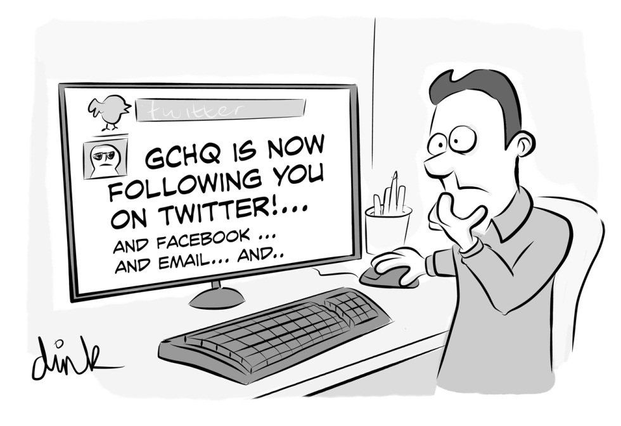
On Her Majesty's Secret Service - GRX & A spy agency
RUXCON 2016
Stephen Kho
22 October 2016

Slide 2
Agenda
Introduction
Why this talk
GRX architecture & protocols
GRX landscape – what we found & why it is interesting
Vulnerabilities, attack vectors & techniques interesting to spy agencies
Mitigation & best practises
Conclusions
Q&A

Slide 3
Who
Stephen Kho
    previously deputy CISO at KPN (Dutch Telco)
    now PS lead at Hewlett Packard Enterprise, Australia
    from Brisbane
Rob Kuiters (not here)
    CERT team lead at KPN
    From Amsterdam
Notes:
Why?
-new 4G LTE technolog

Slide 4


Why
This Talk?
Notes:
Our devices have changed

Slide 5
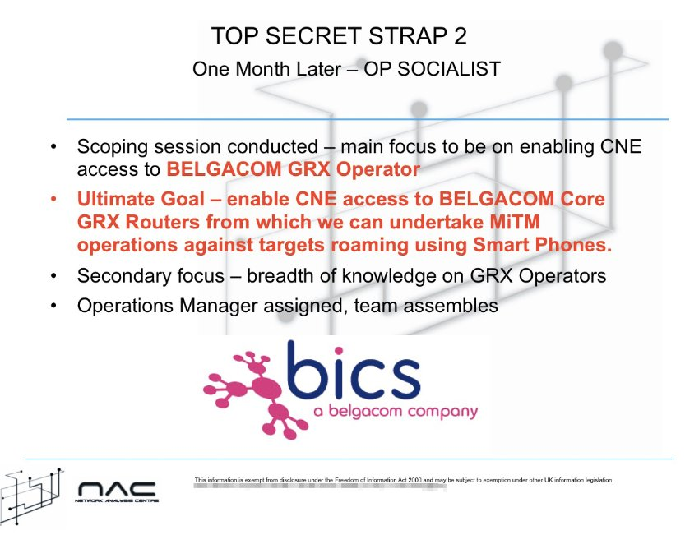
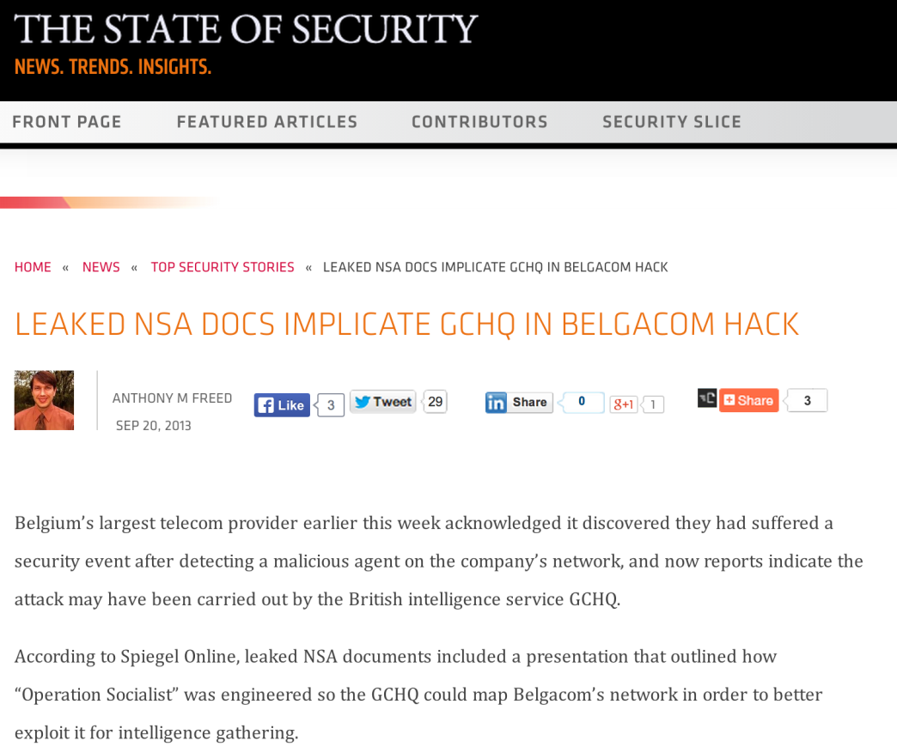
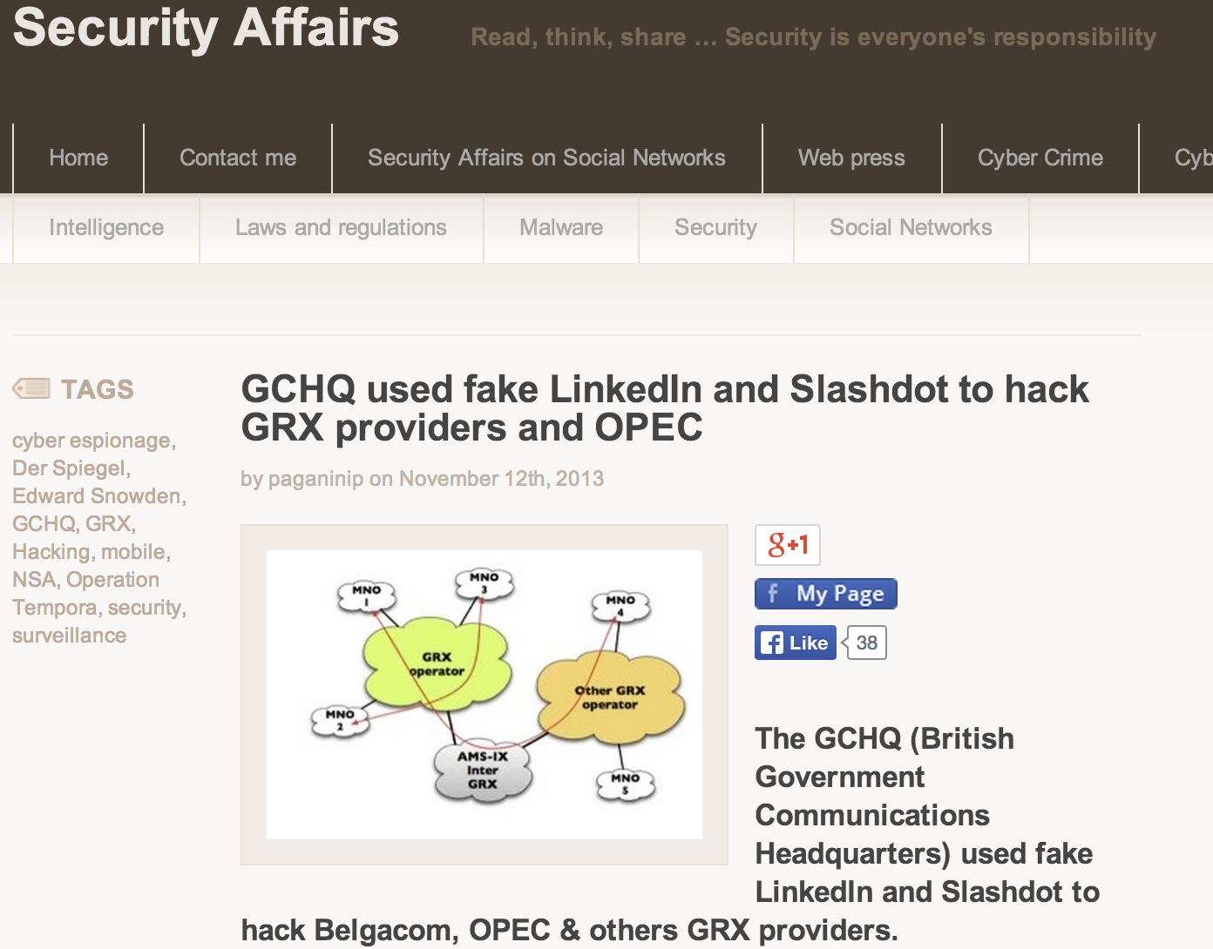
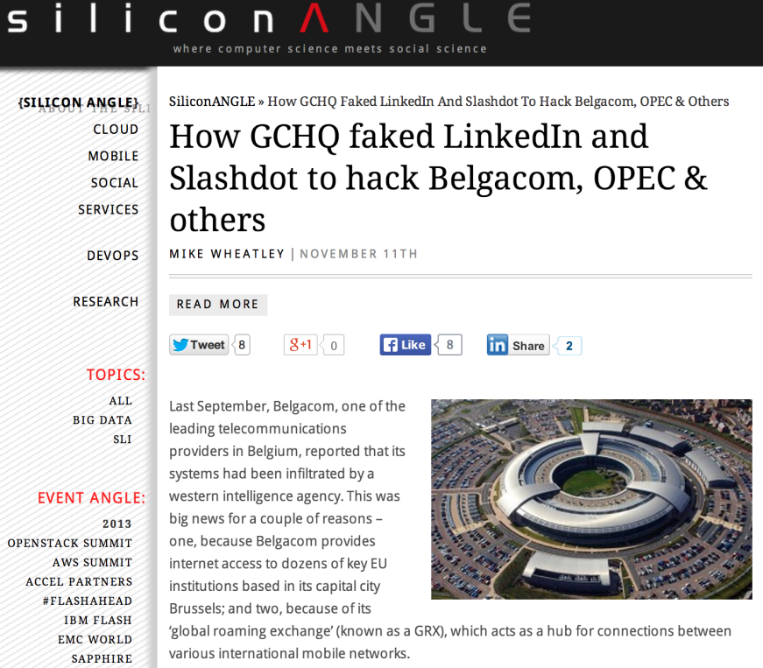
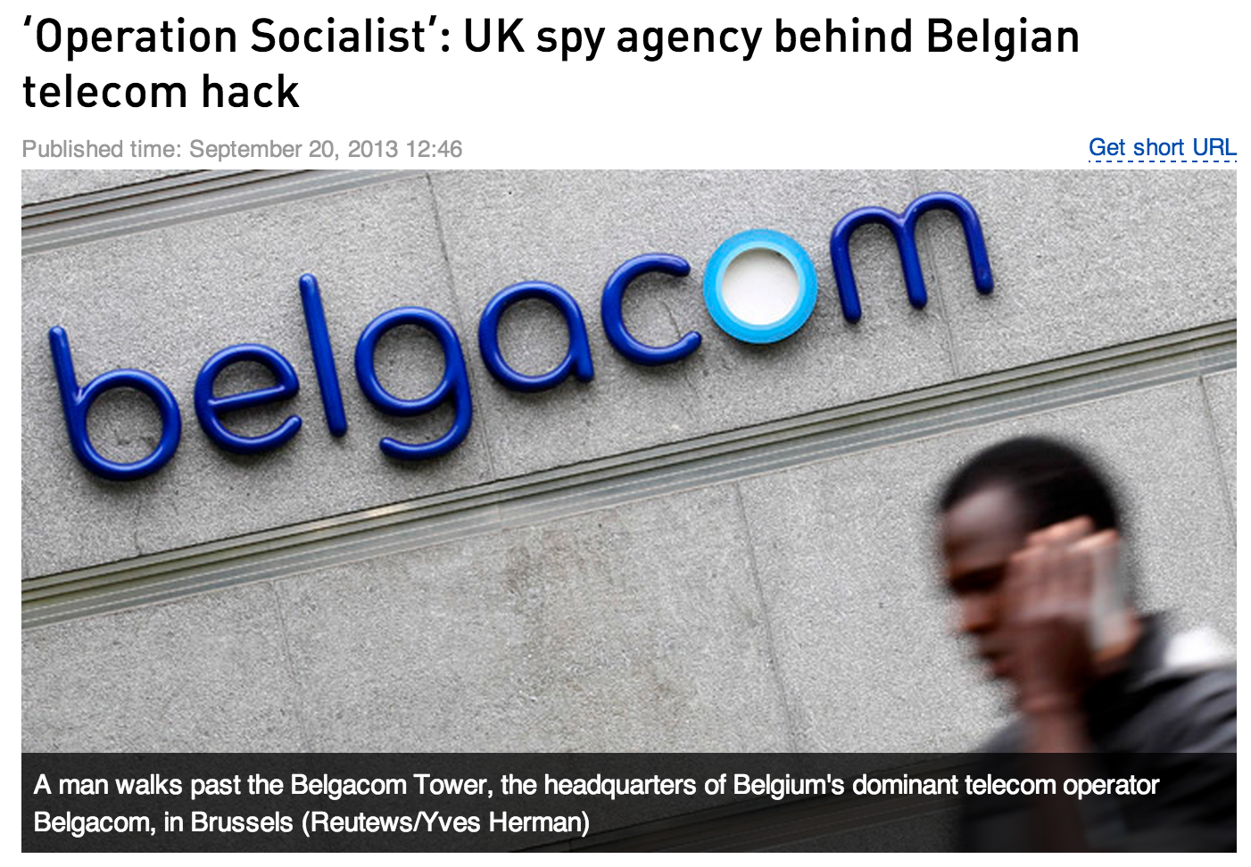
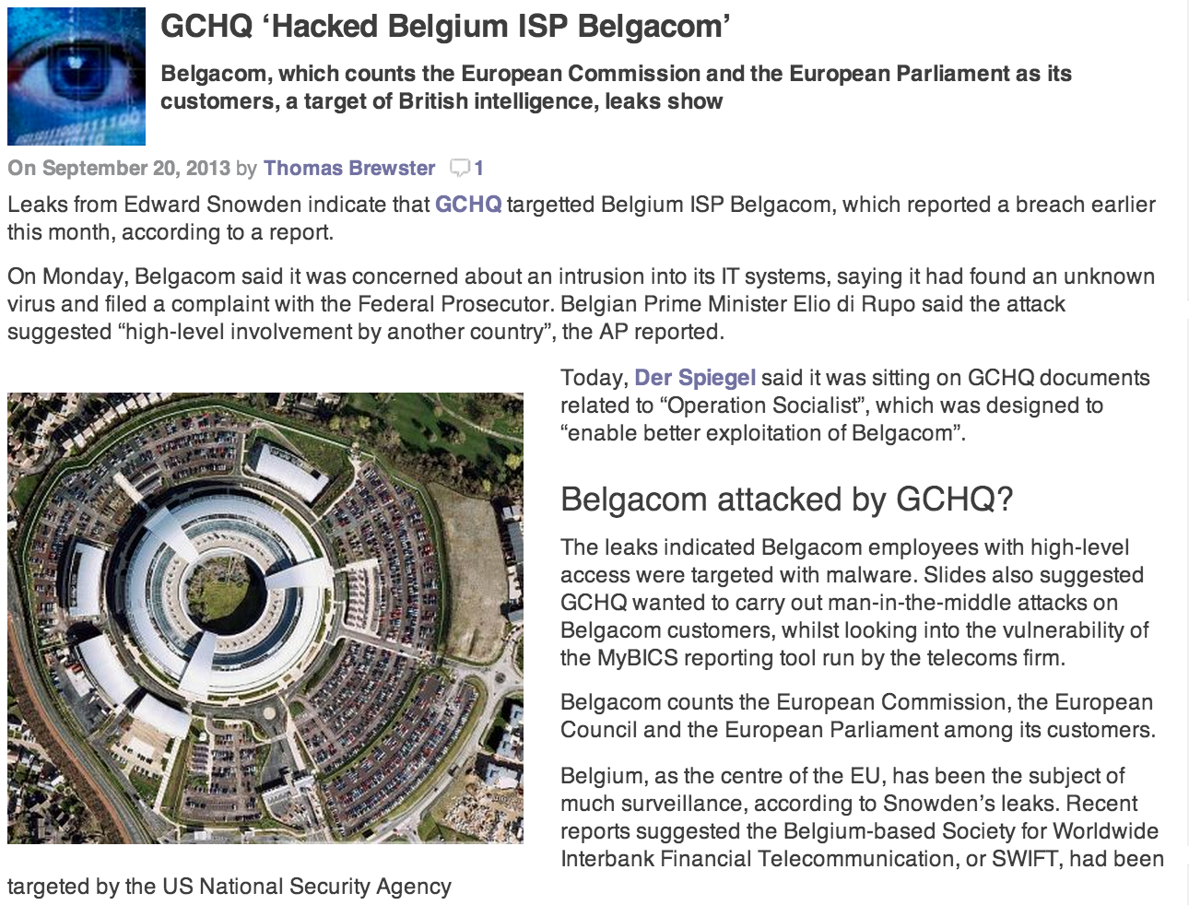




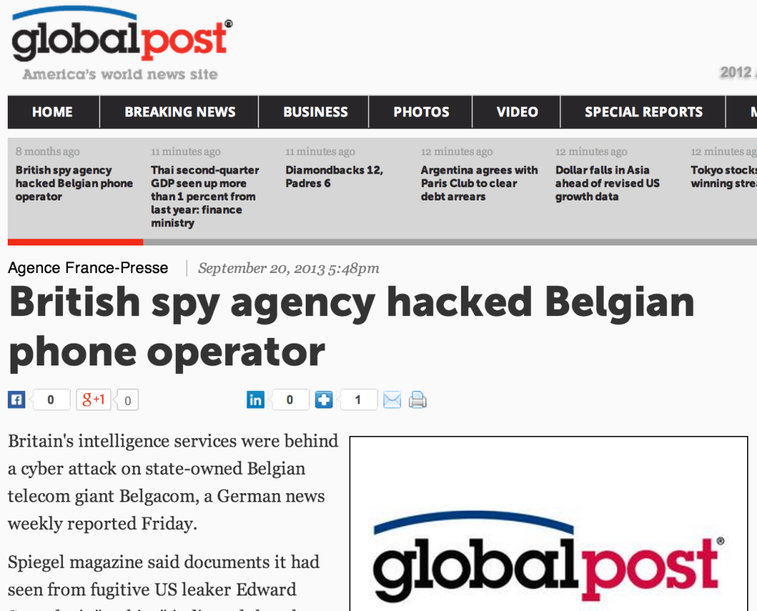
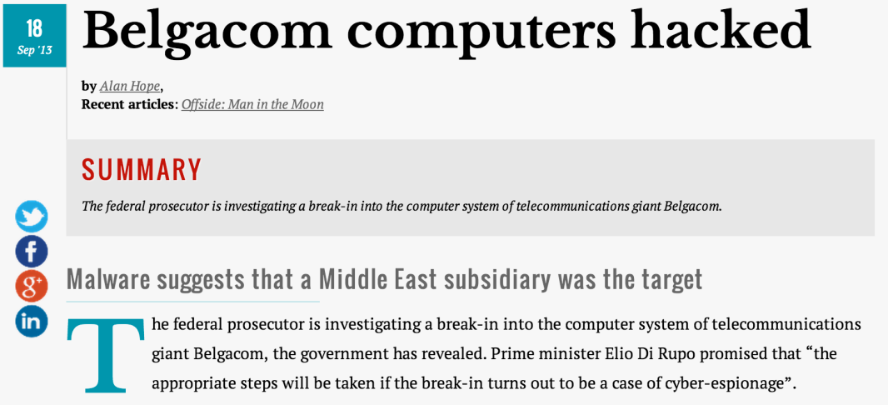
Why this talk?
Kammensmeer

Slide 6

Why this talk?
What is the interest?
Why did they do it?
How would you get in?
Notes:
What could they have seen?
How did they did it?
Why? Obviously cause that’s what they do with tax money

Slide 7

The Concept

Slide 8
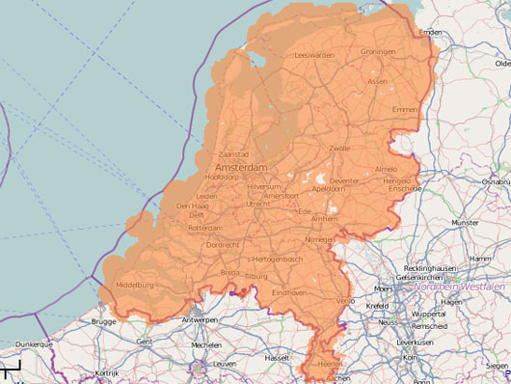
The Concept
Death by abbreviations
Mobility identifiers
48201
114801
Cell Identifier - CI
Routing Area Code – RAC
Mobile Country Code – MCC
Mobile Network Code – MNC
114802
114803
mcc 204
mnc 008

Slide 9
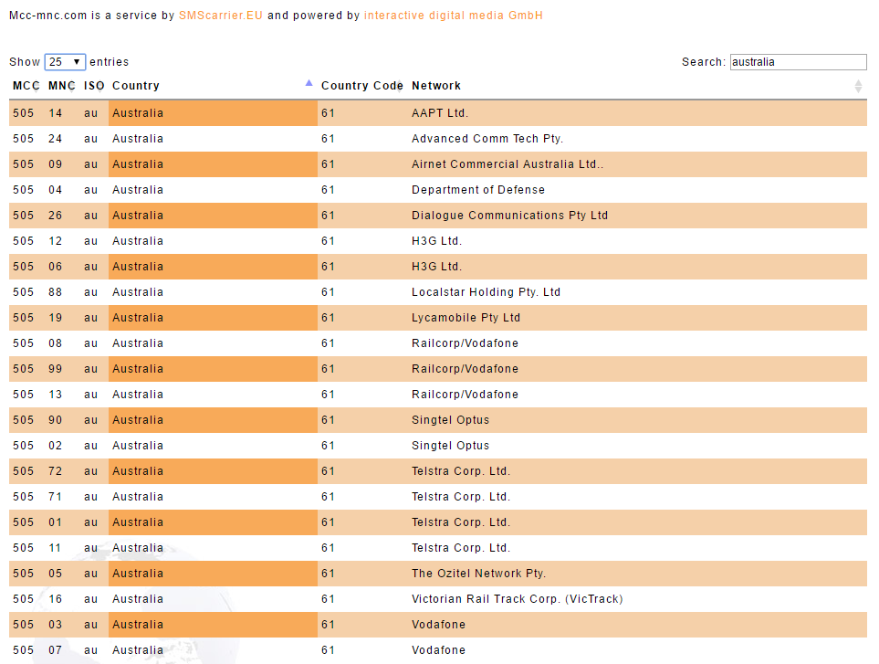
The Concept

Slide 10
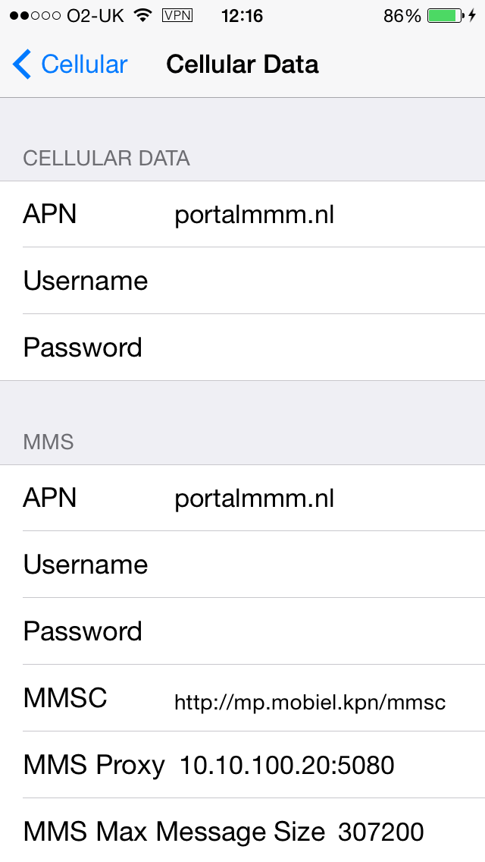

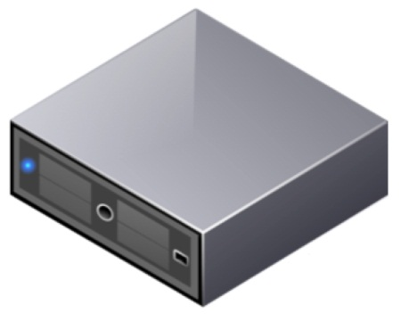

The Concept
Death by Abbreviations
Access Point Name – APN
International Mobile Subscriber Identity – IMSI
Universal Integrated Circuit Card – UICC
Packet Data Protocol Context – PDP Context
internet
internet
.mnc008.mcc204.gprs
.mnc008.mcc204.3gppnetworks.org
mobile network
any packet data network
Gateway

Slide 11



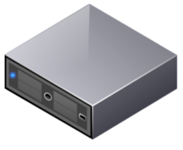
The Concept
Elements
Radio (BTS / nodeB)
Home Location Register
Serving GPRS support node
Gateway GPRS support node
Domain Name Server
Notes:
Our devices have changed

Slide 12


Connecting the Dots
HLR / HSS
Gr / S11
11001100101000101
GGSN / P-GW
Gn / S5
Packet Data Network
SGSN / S-GW
DNS

Slide 13
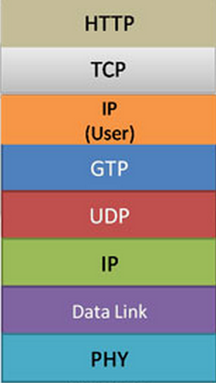


GPRS Tunneling Protocol
End User Data
Mobile Network Operator

Slide 14
GPRS Tunneling Protocol
GTPv0 GPRS
GTPv1 GPRS/UMTS
GTPv2 LTE
UDP 2123 / 2152
UDP 3386
UDP 2123

Slide 15
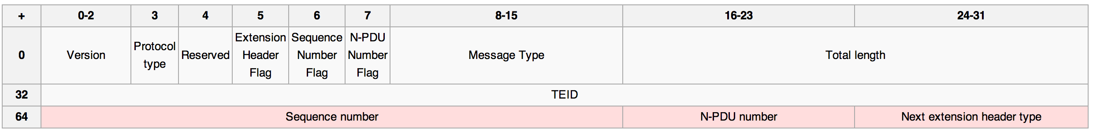
GPRS Tunneling protocol
Header
GTPv1
GTP or GTP’
GTP tunnel end point
Should be 1
Create
Update
Delete
And 20 more
3GPP 29060

Slide 16
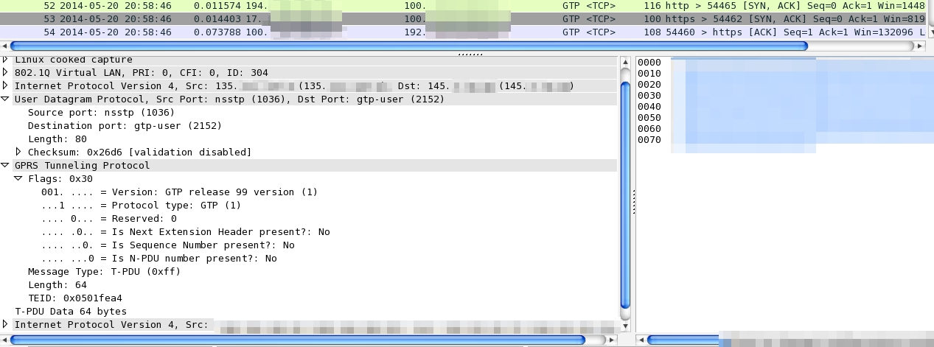
GPRS Tunneling protocol
Header
WireShark output
Should be 1
GTP or GTP’
Transport PDU
GTP tunnel end point

Slide 17
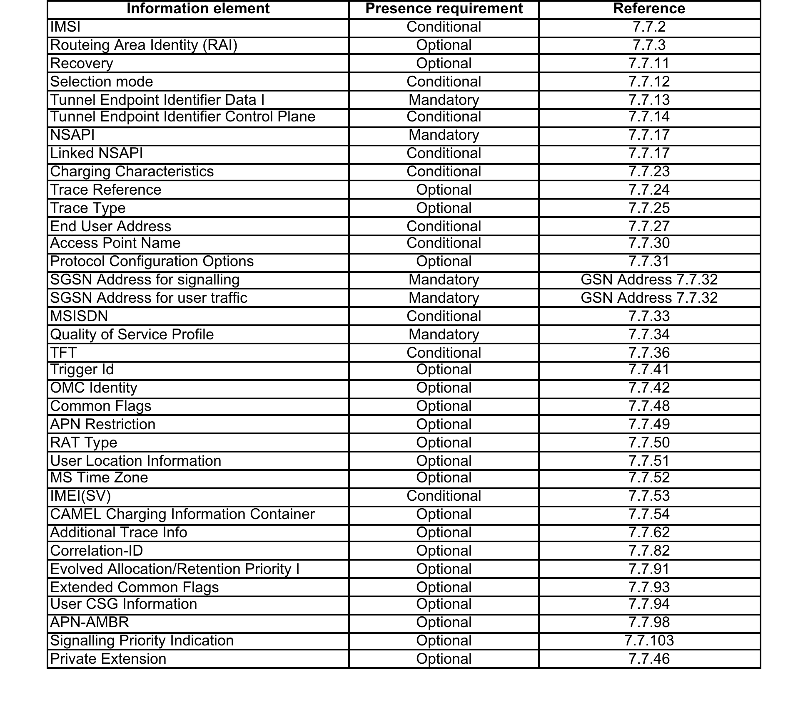
GPRS Tunneling protocol
Information Elements in a Create PDP Context
APN
IMSI
End User Address
User Location Information
IMEI

Slide 18



GPRS Tunneling protocol
SGSN
DNS
GGSN
DNS Query APN IP address
DNS Response APN IP address
Create PDP Context Request
2123
Create PDP Context Response
T-PDU
2152
T-PDU
Delete PDP Context Request
2123
Delete PDP Context Response
Notes:
Our devices have changed

Slide 19

GPRS Roaming eXchange
Notes:
Our devices have changed

Slide 20


GPRS Roaming eXchange
MCC 234
MNC 076
UK BT
HLR
MCC 204
MNC 008
NL KPN
SS7
10101011100
Gn
Gp
Gn
Packet
Data
Network
SGSN
GRX
GGSN
DNS
Notes:
Our devices have changed

Slide 21

GRX architecture & protocols
MNO1
MNO3
GRX2
GRX3
GRX1
MNO4
MNO2
Notes:
Our devices have changed

Slide 22
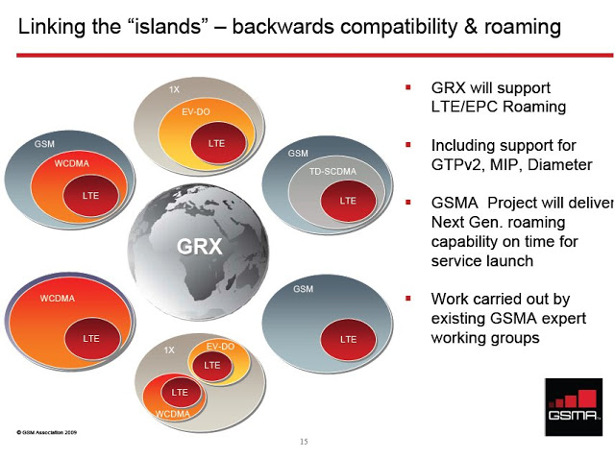
GRX architecture & protocols

Slide 23
GRX providers
  Name City/Country
  AMS-IX Amsterdam/Netherlands
  Astelnet Prague, Czech Republic
  Telefonica Spain Madrid, Spain
  NTT Tokyo, Japan
  Neustar Sterling, VA, USA
  TELE2 Stockholm, Sweden
  Etisalat Abu Dhabi, UAE
  Telenor Oslo, Norway
  Telecom-Austria Vienna, Austria
  Comfone Bern, Switzerland
  Syniverse Florida, USA
  Citic Beijing, China
  Telecom Italia Sparkle Rome, Italy
  Aicent California, USA
  Portugal Telecom Lisbon, Portugal
  T-Systems Frankfurt, Germany
  TDC Copenhagen, Denmark
  Telstra/Reach Melbourne, Australia
  OTE Globe Athens, Greece
  TATA Mumbai, India
  MTT Moscow, Russia
  iBasis/KPN Burlington, USA
  BICS Brussels, Belgium
Notes:
Our devices have changed

Slide 24

GRX providers - HQ
Telenor
TELE2
MTT
AMS-IX
Neustar
BICS
Telefonica
Aicent
CITIC
OTE Globe
Syniverse
Tele. Italia
NTT
iBasis/KPN
Astelnet
T-Systems
TATA
Etisalat
Telstra
Notes:
Our devices have changed

Slide 25
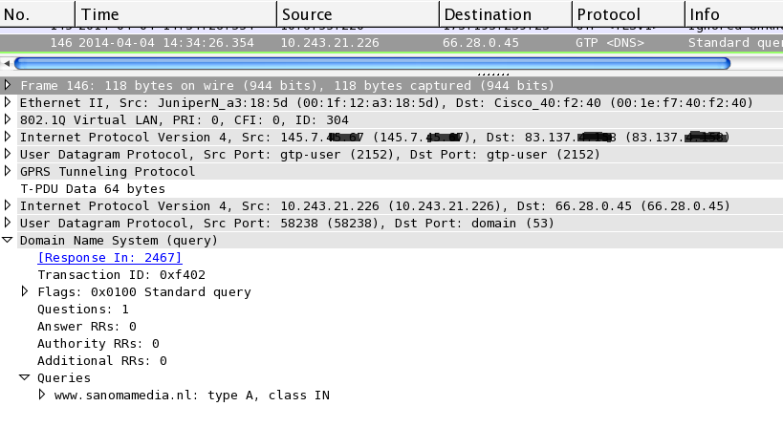
GTP Traffic – why the interest?
GTP traffic captured from GRX router: looks like this in Wireshark:
UE End points
GTP tunnel end points
User plane traffic
Notes:
Our devices have changed

Slide 26
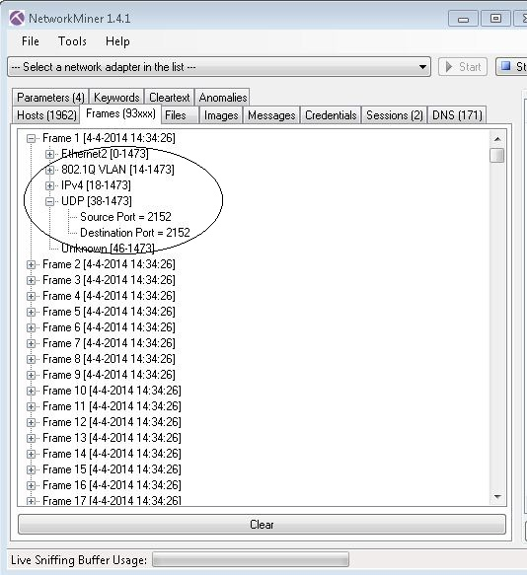
GTP Traffic – why the interest?
Network forensics
NetworkMiner, Explico
Frames loaded but…
Can’t see user plane data
Notes:
Our devices have changed

Slide 27
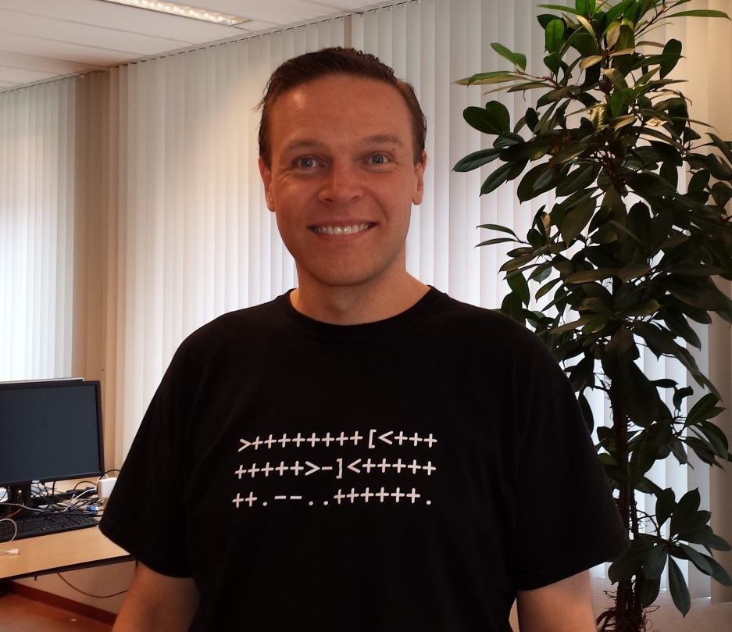
GTP Traffic – why the interest?
Need to remove GTP headers
Here’s Wesley – KPN CERT team
Cool shirts (http://en.wikipedia.org/wiki/Brainfuck)
gtpstrip.c
  identifies link layer header
  detects VLAN tag
  checks for IP header
  checks for UDP header
  confirms GTP user plane traffic
  removes IP, UDP & GTP headers
  re-write frame
Notes:
Our devices have changed

Slide 28
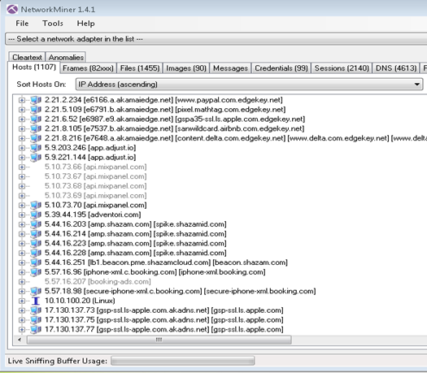
GTP Traffic – why the interest?
Re-load stripped PCAP file
Now can see info:
Hosts details
Notes:
Our devices have changed

Slide 29
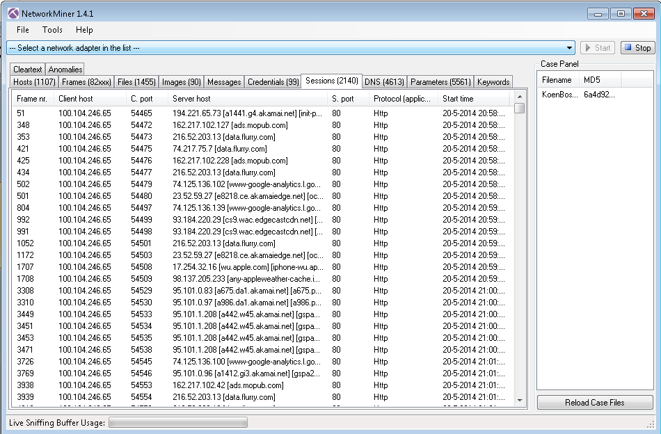
GTP Traffic – why the interest?
Now can see info: Sessions
Notes:
Our devices have changed

Slide 30
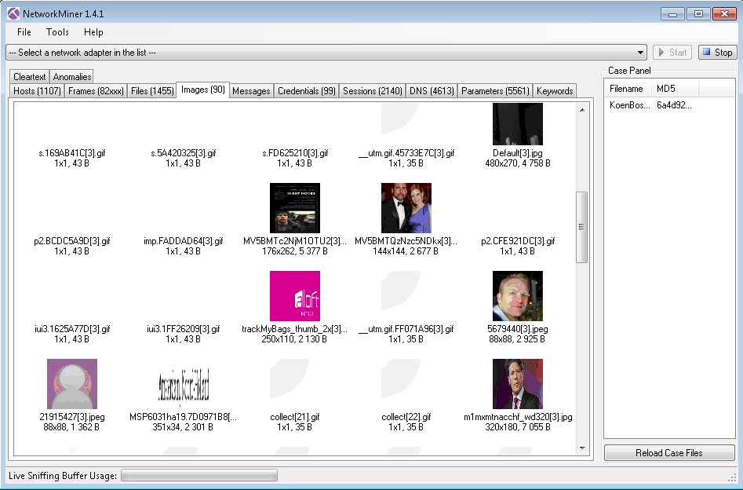
GTP Traffic – why the interest?
Now can see info: Images
Notes:
Our devices have changed

Slide 31
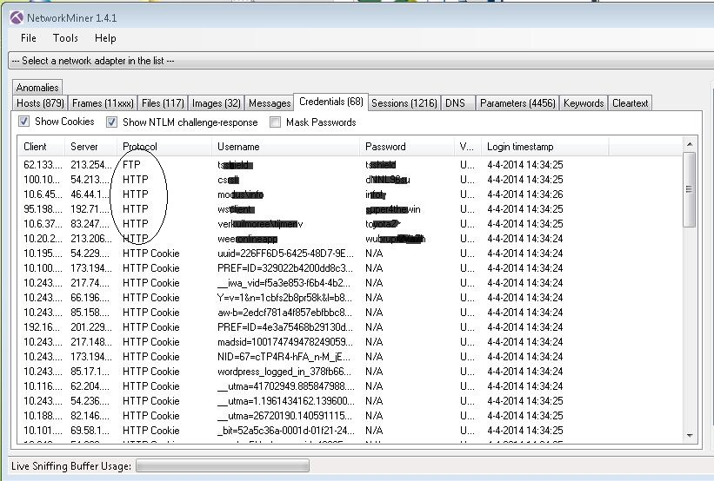
GTP Traffic – why the interest?
Now can see info: Credentials
Notes:
Our devices have changed

Slide 32
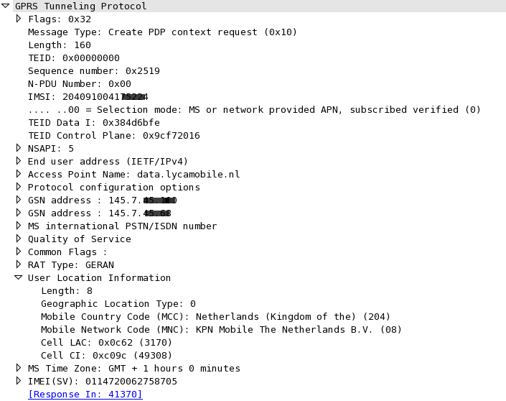
GTP Traffic – why the interest?
What else?
Location details
Device detail
IMSI
MCC
MNC
LAC
CI
IMEI
Notes:
Our devices have changed

Slide 33
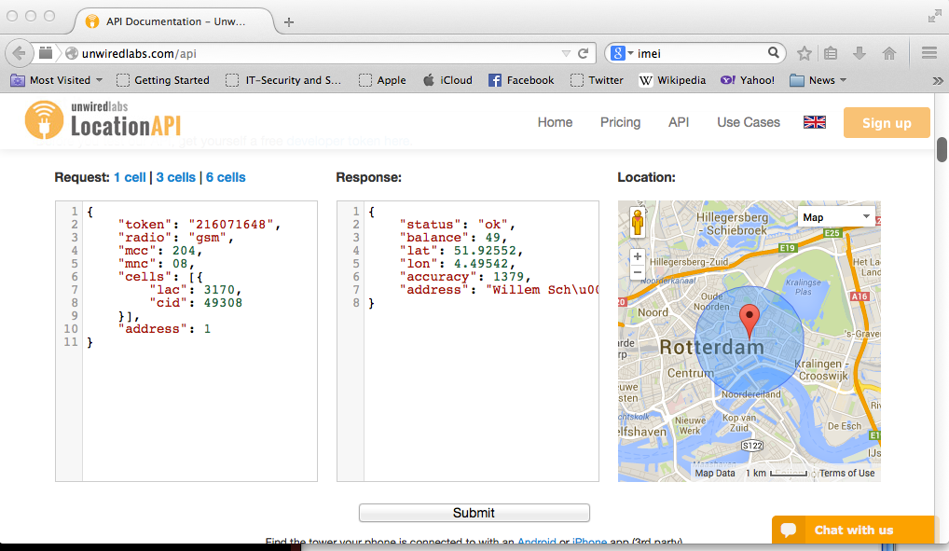
GTP Traffic – why the interest?
MCC, MNC, LAC, CI = your location
http://unwiredlabs.com/api
Notes:
Our devices have changed

Slide 34
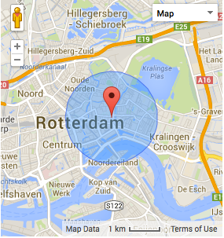
GTP Traffic – why the interest?
MCC, MNC, LAC, CI = your location
Request
{
"token": "216071648",
"radio": "gsm",
"mcc": 204,
"mnc": 08,
"cells": [{
"lac": 3170,
"cid": 49308
}],
"address": 1
}
Response
{
"status": "ok",
"balance": 49,
"lat": 51.92552,
"lon": 4.49542,
"accuracy": 1379,
"address": "Willem Schurmannstraat, Rotterdam, Stadsregio Rotterdam, South Holland, Kingdom of the Netherlands, 3061CT, The Netherlands, European Union"
}
GPS coordinates
Notes:
Our devices have changed

Slide 35
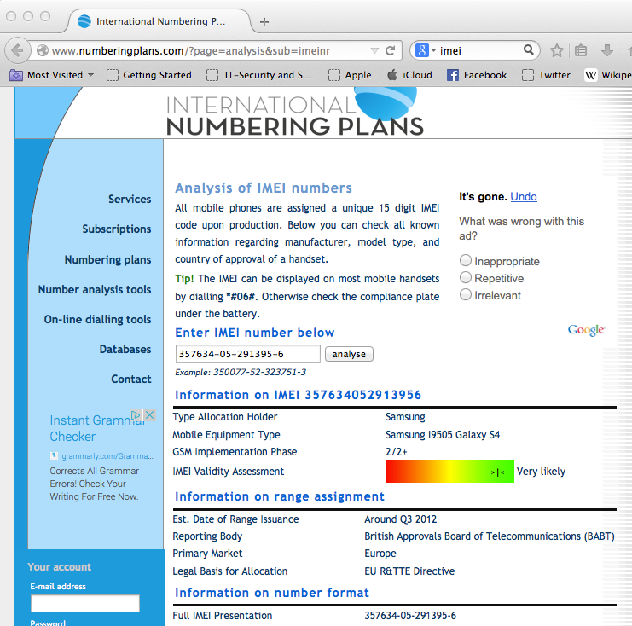
GTP Traffic – why the interest?
IMEI – International Mobile Equipment Identity
http://www.numberingplans.com/
IMEI
Samsung I9505 Galaxy S4
Handset specific payload?
Notes:
Our devices have changed

Slide 36
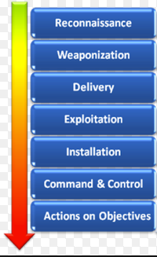
GRX landscape – overview
Now we know the what, who, why
Now need to find and work out How to get unauthorised access?
Kill Chain (Reconnaissance → Weaponization)
  Identify hosts, enumerate service ONLY
GRX BGP routing table (MNOs)
  Total number of subnets: 4.8K
  Total IP address space: 320K
Host discovery - limited port scan & GTP ping
./masscan <target> -p21,22,23,25,80,139,443,445,3868 -oB out-$b.bin
Approximate live hosts: 42K
Notes:
Our devices have changed

Slide 37
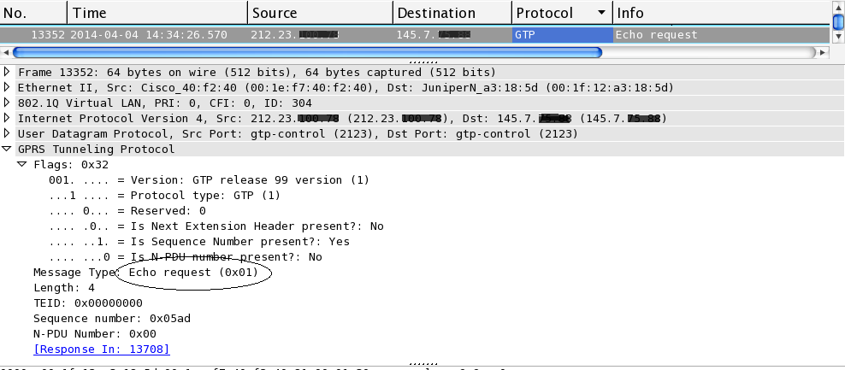
GRX landscape – Looking for GGSNs
Search for GTP ports: UDP 2152 & UDP 2123
GTP echo request looks like this:
Notes:
Our devices have changed

Slide 38
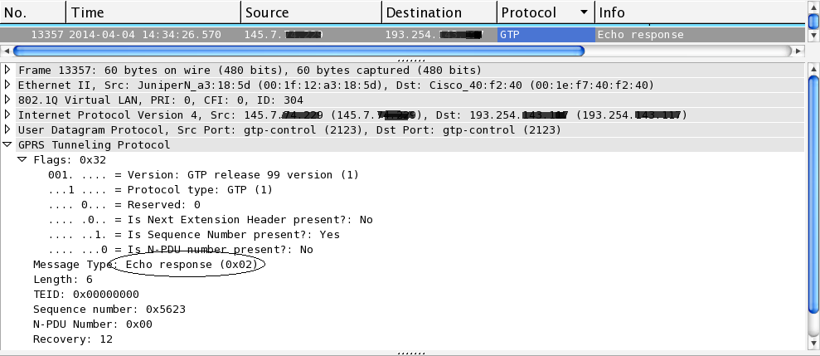
GRX landscape – Looking for GGSNs
GTP echo response looks like this:

Slide 39
GRX landscape – Looking for GGSNs
Scan for GTP ports
  zmap (https://zmap.io/)
  Async & fast – ICMP, TCP, UDP
  Can scale up to 1.4 million packets/sec, good idea to rate limit
zmap -M udp -p 2123 <IP> --probe-args=file:GTP-2123-echo.pkt -o GTP-2123-<IP>.csv -B 1G
Now you’ve found a GTP port, then what?
  Send PDP context request to confirm active GGSN
OpenGGSN project (http://sourceforge.net/projects/ggsn/)
Notes:
Our devices have changed

Slide 40
GRX landscape – Talking to GGSNs
SGSNEMU (part of OpenGGSN)
  connections to the GGSN
  ping request, create PDP context
  forward packets to connections on Gn/Gp interface.
# sgsnemu --listen 192.168.253.249 --remote xx.xx.xx.xx --timelimit 10 --contexts 1 1 --apn internet --imsi 240011234567890 --msisdn 46702123456 –create
<snip>
Initialising GTP library
openggsn[21672]: GTP: gtp_newgsn() started
Setting up interface
Done initialising GTP library
Sending off echo request
Setting up PDP context #0
Waiting for response from ggsn........
Received echo response
Received create PDP context response.
GTP daemon ready to talk!

Slide 41
GRX landscape threat profile
– DNS servers (53/UDP)
DNS on GRX used for resolving APNs to set up GTP tunnel
Typical query for KPN looks like this:
  dig internet.mnc008.mcc204.gprs @ <DNS IP>
DNS response:
  ;; Got answer:
  ;; ->>HEADER<<- opcode: QUERY, status: NOERROR, id: 26251
  ;; flags: qr rd ra; QUERY: 1, ANSWER: 4, AUTHORITY: 4, ADDITIONAL: 8
  ;; QUESTION SECTION:
  ;internet.mnc008.mcc204.gprs. IN A
  ;; ANSWER SECTION:
  internet.mnc008.mcc204.gprs. 300 IN A 145.7.xx.xx
  internet.mnc008.mcc204.gprs. 300 IN A 145.7.xx.xx
  internet.mnc008.mcc204.gprs. 300 IN A 145.7.xx.xx
  internet.mnc008.mcc204.gprs. 300 IN A 145.7.xx.xx
globally agreed APN
Notes:
Our devices have changed

Slide 42
GRX landscape threat profile– DNS servers
  Enumerate versions of DNS
  Command to get Bind version:
    dig chaos txt version.bind @<DNS IP>
    BIND versions 9.2.3 to 9.8.1-P1
    Microsoft DNS 6.0.6002
    Outdated versions with publicly known vulnerabilities
  Bind version 9.2.3
  Bind 9.8.1-P1
  Aside from GTP & DNS – what else?
DoS
CVE-2012-516
CVE-2012-4244
DoS & Buffer Overflow
CVE-2013-4854
CVE-2013-3919
CVE-2013-2266

Slide 43
GRX landscape threat profile – SMTP (25/TCP)
Remote Root Exploit
CVE-2010-4344
  Cisco PIX sanitized smtpd
  Exim smtpd 4.63
  Microsoft ESMTP 5.0.2195.6713
  Postfix smtpd
  Sendmail 1.0, 2.5.3
  Sendmail 8.11.1, 8.11.6+Sun, 8.11.7p1+Sun/8.11.7
  Sendmail 8.12.9+Sun/8.12.9, 8.13.3 rev 1.001
  Sendmail 8.13.7+Sun, 8.13.8+Sun/8.13.8, 8.14.1/8.14.1, 8.14.5+Sun/8.13.4
  Sendmail 8.9.3
  netqmail smtpd 1.04
  qmail smtpd
Remote Code Execution
CVE-2006-0058
Remote Code Exec
CVE-2003-0694
Buffer Overflow
CVE-2002-1337
.
Notes:
Our devices have changed

Slide 44
GRX landscape threat profile
– FTP servers (21/TCP)
Buffer Overflow
CVE 2001-0053
BSD ftpd 6.00
Cisco ftpd 5.3.1
HP-UX ftpd 1.1.214.8
Microsoft ftpd 5.0
OpenBSD ftpd 6.4 (Linux port 6.4)
Sun Solaris 8 ftpd
TopLayer/Alcatel ftpd
VxWorks ftpd 5.4
WU-FTPD 2.6.1 (revision 4.0), wu-2.6.1-16
vsftpd 2.0.4, 2.0.5, 2.0.7, 2.2.2
3Com 3CDaemon ftpd
Axis 211M Network
BulletProof FTPd
FileZilla ftpd 0.9.33, 0.9.40
ProFTPD 1.3.0, 1.3.1
Pure-FTPd
Serv-U ftpd 6.0
Buffer Overflow
CVE-2003-0466
BoF/DoS
CVE-2002-2300
Remote Code Exec
CVE-2006-5815
DoS
CVE-2011-0762
Banner based only!
Notes:
Our devices have changed

Slide 45
GRX landscape threat profile
– Web servers (80,443/TCP)
Apache Tomcat/Coyote JSP engine 1.0, 1.1
Apache httpd 2.0.59, 2.2.14 (Ubuntu)
Apache httpd 2.2.14 (Win32)
Apache httpd 2.2.15 (Red Hat)
Apache httpd 2.2.21 (Unix)
Apache httpd 2.2.22 (FreeBSD)
Apache httpd 2.2.26 (Unix)
Apache httpd 2.2.3 (CentOS)
Apache httpd 2.2.9 (Debian)
Cisco ASA firewall http,Cisco IOS administrative httpd
Microsoft IIS webserver 5.0, 6.0, 7.5
MiniServ (Webmin httpd)
Netscreen administrative web server (Virata-EmWeb/R6_0_1)
Oracle HTTP Server Powered by Apache 1.3.22
lighttpd 1.4.13
Remote Code Exec
CVE-2010-0425
Remote Code Exec
CVE-2013-1862
Remote Code Exec
CVE-2008-1446
DoS/Code Exec
CVE-2002-0392
Why are these servers even here??
Notes:
Our devices have changed

Slide 46
GRX landscape threat profile
– Telnet daemons (23/TCP)
Alcatel 7750 SR router telnetd
BSD-derived telnetd
Cisco IOS telnetd
Cisco PIX 500 series telnetd
Cisco or Edge-core switch telnetd
Cisco router
HP-UX telnetd
Huawei Quidway Eudemon firewall telnetd
Linux telnetd
Microsoft Windows 2000 telnetd
Microsoft Windows XP telnetd
Netscreen ScreenOS telnetd
Nortel Extranet Contivity Secure IP Services telnetd
Openwall GNU/*/Linux telnetd
Sun Solaris telnetd
DoS
CVE-2001-0348
Remote Code Exec
MS01-031
Login Bypass
CVE-2007-0882
Seriously?!
Notes:
Our devices have changed

Slide 47
GRX landscape threat profile
– SMB (Server Message Block) (139,445/TCP)
Mainly used for providing shared access to files
  directly over TCP/445
  via the NetBIOS API (TCP/139)
SMB null sessions = blank username & password
  ./smbclient –N –L //<IP>
Some OSes seen:
Domain=[WORKGROUP] OS=[Unix] Server=[Samba 3.6.3]
Domain=[XX] OS=[Windows 5.0] Server=[Windows 2000 LAN Manager]
Domain=[WORKGROUP] OS=[Windows Server 2008 R2 Standard 7601 Service Pack 1] Server=[Windows Server 2008 R2 Standard 6.1]
Domain=[WORKGROUP] OS=[Windows Server 2003 3790 Service Pack 2] Server=[Windows Server 2003 5.2]
Remote Code Exec
CVE-2012-1182
Remote Code Exec
CVE-2008-4835
CVE-2012-1182
Looks like people are mixing GRX and office network!

Slide 48
GRX landscape threat profile –SMB (139,445/TCP)
Information disclosure via null session
Starting enum4linux v0.8.8 ( http://labs.portcullis.co.uk/application/enum4linux/ )
  ==========================================
  | Share Enumeration on xx.xx.xx.xx |
  ==========================================
  Domain=[WORKGROUP] OS=[Unix] Server=[Samba 3.6.3]
  Domain=[WORKGROUP] OS=[Unix] Server=[Samba 3.6.3]
  Sharename Type Comment
  --------- ---- -------
  IPC$ IPC IPC Service (HOST Server)
  DataDisk2 Disk DataDisk2
  DataDisk1 Disk DataDisk1
  Server Comment
  --------- -------
  COMP2
  COMP4
  COMP5
  COMP7
  COMP9
  CONFERENCE
  XXX
  HOST HOST Server
  ===================================
  | Password Policy Information for xx.xx.xx.xx |
  ===================================
  [+] Attaching to xx.xx.xx.xx using a NULL share
  [+] Trying protocol 445/SMB…
  [+] Found domain(s):
  [+] HOST
  [+] Builtin
  [+] Password Info for Domain: HOST
  [+] Minimum password length: 5
  [+] Password history length: None
  [+] Maximum password age: Not Set
  [+] Password Complexity Flags: 000000
  [+] Domain Refuse Password Change: 0
  [+] Domain Password Store Cleartext: 0
  [+] Domain Password Lockout Admins: 0
  [+] Domain Password No Clear Change: 0
  [+] Domain Password No Anon Change: 0
  [+] Domain Password Complex: 0
  [+] Minimum password age: None
  [+] Reset Account Lockout Counter: 30 minutes
  [+] Locked Account Duration: 30 minutes
  [+] Account Lockout Threshold: None
  [+] Forced Log off Time: Not Set
  [+] Retieved partial password policy with rpcclient:
  Password Complexity: Disabled
  Minimum Password Length: 5

Slide 49
GRX landscape – SNMP (UDP/161)
Default community strings: PUBLIC & PRIVATE
  Possibly execute arbitrary commands
  Shutdown machines
  Stop & start tasks, change settings
  Gain valuable information
sysDescr.0 = STRING: AGENT++v3.5.27 ATM Simulation Agent
sysDescr.0 = STRING: Cisco IOS Software, 1841 Software (C1841-IPBASE-M), Version 12.4(15)T12
sysDescr.0 = STRING: Cisco IOS Software, 2800 Software (C2800NM-ADVIPSERVICESK9-M), Version 12.4(11)T1,
sysDescr.0 = STRING: Cisco IOS Software, 3800 Software (C3825-IPBASE-M), Version 12.4(3h),
sysDescr.0 = STRING: Cisco IOS Software, 7200 Software (C7200-ADVENTERPRISEK9-M), Version 12.4(4)T1
sysDescr.0 = STRING: Cisco IOS Software, C1900 Software (C1900-UNIVERSALK9-M), Version 15.1(4)M4
sysDescr.0 = STRING: Cisco IOS Software, C2600 Software (C2600-IPVOICE_IVS-M), Version 12.4(9)T
sysDescr.0 = STRING: Cisco IOS Software, C2900 Software (C2900-UNIVERSALK9_NPE-M), Version 15.1(4)M3
sysDescr.0 = STRING: Cisco IOS Software, C3560E Software (C3560E-UNIVERSALK9-M), Version 12.2(50)SE2
sysDescr.0 = STRING: Cisco IOS Software, C3900e Software (C3900e-UNIVERSALK9-M), Version 15.2(4)M6a,
sysDescr.0 = STRING: Cisco IOS Software, c7600rsp72043_rp Software (c7600rsp72043_rp-ADVENTERPRISEK9-M), Version 15.1(3)S5
sysDescr.0 = STRING: Cisco IOS Software, C880 Software (C880DATA-UNIVERSALK9-M), Version 15.0(1)M8
sysDescr.0 = STRING: Cisco IOS Software, IOS-XE Software (PPC_LINUX_IOSD-ADVENTERPRISEK9-M), Version 15.1(3)S
sysDescr.0 = STRING: Cisco IOS Software, MWAM Software (MWAM-G8IS-M), Version 12.3(14)YQ8
sysDescr.0 = STRING: CSP CSP VPN Gate 3.1.10330
sysDescr.0 = STRING: DrayTek Corporation
sysDescr.0 = STRING: DT 815
sysDescr.0 = STRING: Ericsson IPOS-12.1.109.8p1-Release

Slide 50
GRX landscape – SNMP (UDP/161)
Default community strings: PUBLIC & PRIVATE
  Possibly execute arbitrary commands
  Shutdown machines
  Stop & start tasks, change settings
  Gain valuable information
sysDescr.0 = STRING: AGENT++v3.5.27 ATM Simulation Agent
sysDescr.0 = STRING: Cisco IOS Software, 1841 Software (C1841-IPBASE-M), Version 12.4(15)T12
sysDescr.0 = STRING: Cisco IOS Software, 2800 Software (C2800NM-ADVIPSERVICESK9-M), Version 12.4(11)T1,
sysDescr.0 = STRING: Cisco IOS Software, 3800 Software (C3825-IPBASE-M), Version 12.4(3h),
sysDescr.0 = STRING: Cisco IOS Software, 7200 Software (C7200-ADVENTERPRISEK9-M), Version 12.4(4)T1
sysDescr.0 = STRING: Cisco IOS Software, C1900 Software (C1900-UNIVERSALK9-M), Version 15.1(4)M4
sysDescr.0 = STRING: Cisco IOS Software, C2600 Software (C2600-IPVOICE_IVS-M), Version 12.4(9)T
sysDescr.0 = STRING: Cisco IOS Software, C2900 Software (C2900-UNIVERSALK9_NPE-M), Version 15.1(4)M3
sysDescr.0 = STRING: Cisco IOS Software, C3560E Software (C3560E-UNIVERSALK9-M), Version 12.2(50)SE2
sysDescr.0 = STRING: Cisco IOS Software, C3900e Software (C3900e-UNIVERSALK9-M), Version 15.2(4)M6a,
sysDescr.0 = STRING: Cisco IOS Software, c7600rsp72043_rp Software (c7600rsp72043_rp-ADVENTERPRISEK9-M), Version 15.1(3)S5
sysDescr.0 = STRING: Cisco IOS Software, C880 Software (C880DATA-UNIVERSALK9-M), Version 15.0(1)M8
sysDescr.0 = STRING: Cisco IOS Software, IOS-XE Software (PPC_LINUX_IOSD-ADVENTERPRISEK9-M), Version 15.1(3)S
sysDescr.0 = STRING: Cisco IOS Software, MWAM Software (MWAM-G8IS-M), Version 12.3(14)YQ8
sysDescr.0 = STRING: CSP CSP VPN Gate 3.1.10330
sysDescr.0 = STRING: DrayTek Corporation
sysDescr.0 = STRING: DT 815
sysDescr.0 = STRING: Ericsson IPOS-12.1.109.8p1-Release
Cisco IOS 1841
Cisco IOS 2800
Cisco IOS 3800
Cisco IOS 7200
Cisco IOS C2600
Cisco IOS C2900
Cisco IOS C3560
Cisco IOS C3900
Cisco IOS C7600
Cisco IOS-XE
Cisco CSP VPN Gate 3.1
DrayTek Corp
Ericsson IPOS-12.1

Slide 51
GRX landscape – SNMP
SNMP UDP/161
Default community strings: PUBLIC & PRIVATE
sysDescr.0 = STRING: Hardware: x86 Family 15 Model 4 Stepping 8 AT/AT COMPATIBLE - Software: Windows Version 5.2 (Build 3790 Multiprocessor Free)
sysDescr.0 = STRING: Hardware: x86 Family 6 Model 11 Stepping 1 AT/AT COMPATIBLE - Software: Windows 2000 Version 5.0 (Build 2195 Multiprocessor Free)
sysDescr.0 = STRING: Hexabyte ADSL
sysDescr.0 = STRING: Huawei Versatile Routing Platform Software, Software Version 3.10, Release 0031P11
sysDescr.0 = STRING: Linux ADSL2PlusRouter 2.6.19 #2 Wed Aug 22 19:44:52 CST 2012 mips
sysDescr.0 = STRING: Linux iTOP-01 2.6.32.59-0.7-default #1 SMP 2012-07-13 15:50:56 +0200 x86_64
sysDescr.0 = STRING: Product: MG 2K;SW Version: 5.60.000.003
sysDescr.0 = STRING: Quidway E300 Firewall, Huawei Versatile Routing Platform Software,
sysDescr.0 = STRING: Redback Networks SmartEdge OS Version SEOS-11.1.2.9-Release
sysDescr.0 = STRING: RouterOS CCR1036-12G-4S
sysDescr.0 = STRING: SUN NETRA X4250, ILOM v3.0.3.30, r47608
sysDescr.0 = STRING: SunOS dpireport 5.10 Generic_127128-11 i86pc
sysDescr.0 = STRING: Sun SNMP Agent, Netra-240
sysDescr.0 = STRING: TANDBERG Codec
sysDescr.0 = STRING: ucd-snmp-4.1.2/Red Hat eCos
sysDescr.0 = STRING: ZXR10 ROS Version V4.8.11.01 ZXR10 T64G Software, Version ZXR10 G-Series&8900&6900 V2.8.01.C.27.P06 Copyright (c) 2001-2009 by ZTE Corporation Compiled Sep 11 2009, 17:15:50
sysDescr.0 = STRING: ZXR10 xGW-16, ZTE ZXR10 Software Version: ZXUN xGW(GGSN)V4.10.10(1.0.0)
sysDescr.0 = STRING: ZyXEL MAX-207HW2/2R

Slide 52
GRX landscape – SNMP
SNMP UDP/161
Default community strings: PUBLIC & PRIVATE
sysDescr.0 = STRING: Hardware: x86 Family 15 Model 4 Stepping 8 AT/AT COMPATIBLE - Software: Windows Version 5.2 (Build 3790 Multiprocessor Free)
sysDescr.0 = STRING: Hardware: x86 Family 6 Model 11 Stepping 1 AT/AT COMPATIBLE - Software: Windows 2000 Version 5.0 (Build 2195 Multiprocessor Free)
sysDescr.0 = STRING: Hexabyte ADSL
sysDescr.0 = STRING: Huawei Versatile Routing Platform Software, Software Version 3.10, Release 0031P11
sysDescr.0 = STRING: Linux ADSL2PlusRouter 2.6.19 #2 Wed Aug 22 19:44:52 CST 2012 mips
sysDescr.0 = STRING: Linux iTOP-01 2.6.32.59-0.7-default #1 SMP 2012-07-13 15:50:56 +0200 x86_64
sysDescr.0 = STRING: Product: MG 2K;SW Version: 5.60.000.003
sysDescr.0 = STRING: Quidway E300 Firewall, Huawei Versatile Routing Platform Software,
sysDescr.0 = STRING: Redback Networks SmartEdge OS Version SEOS-11.1.2.9-Release
sysDescr.0 = STRING: RouterOS CCR1036-12G-4S
sysDescr.0 = STRING: SUN NETRA X4250, ILOM v3.0.3.30, r47608
sysDescr.0 = STRING: SunOS dpireport 5.10 Generic_127128-11 i86pc
sysDescr.0 = STRING: Sun SNMP Agent, Netra-240
sysDescr.0 = STRING: TANDBERG Codec
sysDescr.0 = STRING: ucd-snmp-4.1.2/Red Hat eCos
sysDescr.0 = STRING: ZXR10 ROS Version V4.8.11.01 ZXR10 T64G Software, Version ZXR10 G-Series&8900&6900 V2.8.01.C.27.P06 Copyright (c) 2001-2009 by ZTE Corporation Compiled Sep 11 2009, 17:15:50
sysDescr.0 = STRING: ZXR10 xGW-16, ZTE ZXR10 Software Version: ZXUN xGW(GGSN)V4.10.10(1.0.0)
sysDescr.0 = STRING: ZyXEL MAX-207HW2/2R
Windows 2000
Windows 2003
Hexabyte ADSL
Huawei VRP router
Linux ADSL2PlusRouter
Huawei Quidway E300 FW/VRP Router
Redback Networks SmartEdge OS
SUN NETRA X4250
SunOS 5.10
Sun Netra-240
TANDBERG Codec
RedHat eCOs
ZTE ZXR10 ROS V4.8.11.01
ZTE ZXR10 GGSN V4.10.10
ZyXEL MAX-207HW2

Slide 53
GRX landscape – the numbers
Summary of open ports on GRX hosts found during this “light” survey
Service | Open port | Number
DNS | UDP/53 | 413
GTP | UDP/2123 UDP/2152 | 770 1042
Diameter | TCP/3868 | 177
SMTP | TCP/25 | 401
HTTP | TCP/80 | 1425
Telnet | TCP/23 | 1181
SMB | TCP/139 TCP/445 | 208 115
FTP | TCP/21 | 810
SNMP | UDP/161 | 219
These were found from the Internet!
Out of the 42K GRX live hosts
5.5K hosts from over 200 operators were reachable from the Internet!
Over 15 operators had GTP ports exposed to the Internet
May not need to be IN GRX to access GRX

Slide 54
On Her Majesty's Secret Service - GRX & A spy agency - Conclusion
GRX traffic is interesting (and definitely for spy agencies!)
GRX is not a closed off network as was agreed
Over 200 operators distribute BGP route prefixes to both GRX & Internet
5.5K GRX hosts reachable from the Internet
Misconfigurations, vulnerable & unnecessary services running
Security best practices such as ingress filtering not commonly adopted
Mobile operators need more security awareness & testing

Slide 55

Mitigation & best practises
All systems
Update & apply security patch
Harden and remove all unnecessary services
BGP
Remove GRX prefixes from Internet routers
Use BGP authentication
Routers import only specific prefixes from specific AS numbers with roaming agreements
Ingress filtering
  permit BGP sessions
  block spoofed IP addresses (RFC1918,3330)
  permit GTP (v1&2) towards GGSNs
  permit DNS traffic to DNS systems
  permit ICMP echo-reply & request from upstream
  block all others
Use protocol aware firewalls (GTP, SCTP, Diameter)
Implement network segmentation & filtering
Utilise centralised identity and access management
Enforce vendor security patch update
Implement security patch management
Perform regular vulnerability scans
Carry out in-depth penetration tests
Implement host & network based IDS
Practice incident response

Slide 56
Follow up actions since initial publication
Followed up on exposed operators
Rescan of the GRX subnets from Internet
GGSN fuzzing and GTP service exploit development
Telco protocols firewall aware review & testing (GTP, SCTP, Diameter)
IR77 – operator security requirements from GSMA
Metasploit Auxiliary Module – GTP echo & PDP context create scanner

Slide 57
GRX landscape – the numbers - REVISITED
Summary of open ports on GRX hosts found during this “light” survey
Service | Open port | Numbers (May 2014) | Numbers (October 2016) | +/-
DNS | UDP/53 | 413 | 174 | -
GTP | UDP/2123 UDP/2152 | 770 1042 | 1221 1062 | + +
Diameter | TCP/3868 | 177 | 65 | -
SMTP | TCP/25 | 401 | 158 | -
HTTP | TCP/80 | 1425 | 1004 | -
Telnet | TCP/23 | 1181 | 355 | -
SMB | TCP/139 TCP/445 | 208 115 | 232 81 | + -
FTP | TCP/21 | 810 | 340 | -
SNMP | UDP/161 | 219 | 161 | -

Slide 58
GTP ports (UDP 2123/2152) exposure distribution
- over 15 operators
Notes:
Our devices have changed

Slide 59


IR77 GSMA Inter Operator Requirements
Thou shalt take care of
(Doc. Ref: IR 77 vs2.0, Oct 2007)
Confidentiality
Availability
Integrity

Slide 60

IR77 GSMA Inter Operator Requirements
Revised version
Pro
Binding security requirements
Best practices
Con
Still high level
No testing guidelines
No monitoring or enforcing

Slide 61

Thank you! Resource list
OpenGGSN project
http://sourceforge.net/projects/ggsn/
Location API
http://unwiredlabs.com/api
Network Miner
http://www.netresec.com/?page=NetworkMiner
Enum4linux
http://labs.portcullis.co.uk/application enum4linux/
ZMAP
https://zmap.io
Masscan
https://github.com/robertdavidgraham/masscan
GTP specification
http://www.3gpp.org/DynaReport/29060.htm
stephen.kho@hpe.com
rob.kuiters@kpn.com

